Slide 1
Microsoft Entra + SAP Scenarios
Mark Wahl
Principal Product Architect
Rodrigo Fonseca
Principal Product Manager

Slide 2
Agenda
IAM & SAP Modernization
SAP IDM Migration Path
HR Provisioning
Single Sign-On
App Provisioning
Access Management
Reporting
SAP IDM Migration Roadmap
SAP Integration Roadmap
Reference Architecture
Q&A

Slide 3
IAM & SAP Modernization: A Strategic Alignment
IAM modernization represents a critical phase within the larger SAP modernization journey.
IAM Scenario Migration: Streamlining identity management by transitioning from SAP IDM to Microsoft Entra.
SAP Modernization: Moving to cloud-based solutions like HCM to SuccessFactors for HCM and SAP R/3 to S/4HANA.
Consolidation: Cleaning up outdated integrations, roles, and access rights.
Customer Journey: Each step, whether adopting SuccessFactors or planning for S/4HANA, is part of the overall modernization direction.
Notes:
Organizations often align their Identity and Access Management (IAM) scenario migration with broader SAP modernization initiatives. This can include transitioning various non-identity management scenarios from on-premises SAP solutions to cloud services such as SuccessFactors and S/4HANA. It presents an opportune moment to streamline processes by eliminating obsolete integrations, access rights, roles, and consolidating them as needed.
IAM modernization represents a critical phase within the larger SAP modernization journey. For instance:
Transitioning from SAP Identity Management (IDM) to Microsoft Entra
Migrating from SAP Human Capital Management (HCM) to SuccessFactors
Upgrading from SAP R/3 to S/4HANA
While some customers may have already adopted SuccessFactors or other cloud services, planning for S/4HANA might still be on the horizon. Nonetheless, these steps collectively signify the overarching direction towards modernization.

Slide 4
SAP IDM Migration Path
Entra ID is the new Identity Store
User Management goes to Entra ID or AD DS
Connect HR sources to Microsoft Entra
Migrate End User Self-Service to Microsoft Entra
Configure SSO and provision identities for Apps
Migrate Access Lifecycle Management
Identity Federation (B2B)
Extend Microsoft Entra via Low-Code interfaces
Reporting
Use Entra ID or AD DS to provide Directory Services
Migrate identity management scenarios from SAP IDM to Microsoft Entra

Slide 5
HR Provisioning

Slide 6
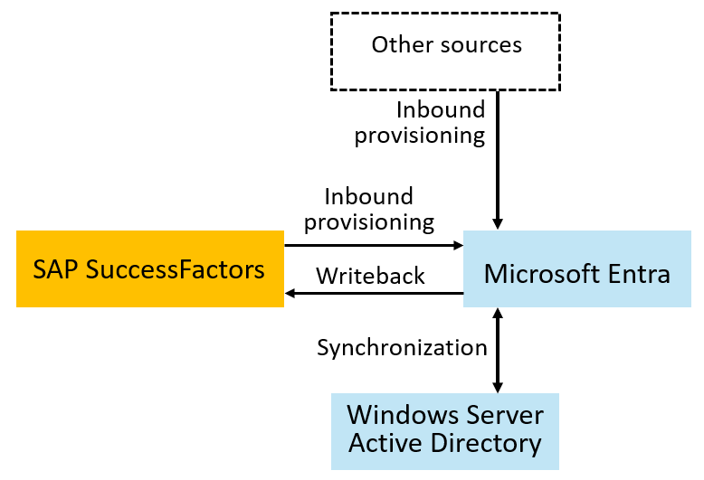
Integrate with HR Sources – SAP SuccessFactors
Organizations with SAP SuccessFactors easily connect to bring identities for employees from SuccessFactors into Microsoft Entra ID or from SuccessFactors into on-premises Active Directory
Notes:
Migrate identity management scenarios from SAP IDM to Microsoft Entra | Microsoft Learn

Slide 7
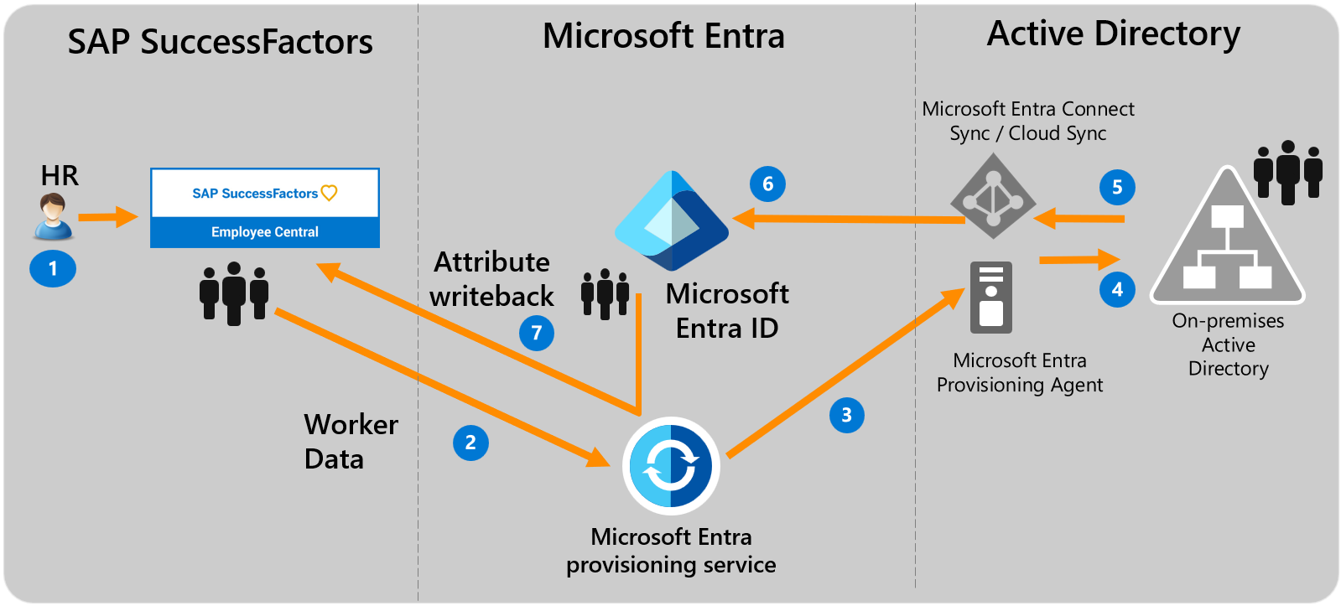
Integrate with HR Sources – SAP SF + AD DS (Hybrid Identity)
Notes:
https://learn.microsoft.com/en-us/entra/identity/saas-apps/sap-successfactors-inbound-provisioning-tutorial

Slide 8
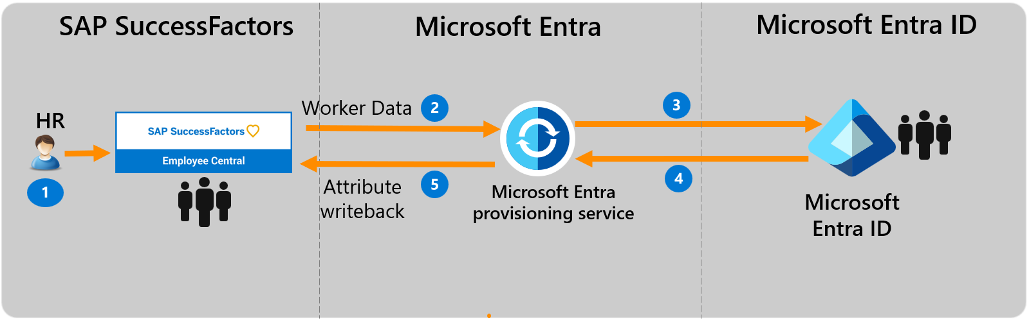
Integrate with HR Sources – SAP SF + Entra ID (Cloud-only)
Notes:
https://learn.microsoft.com/en-us/entra/identity/app-provisioning/sap-successfactors-integration-reference
https://learn.microsoft.com/en-us/entra/identity/saas-apps/sap-successfactors-inbound-provisioning-cloud-only-tutorial

Slide 9
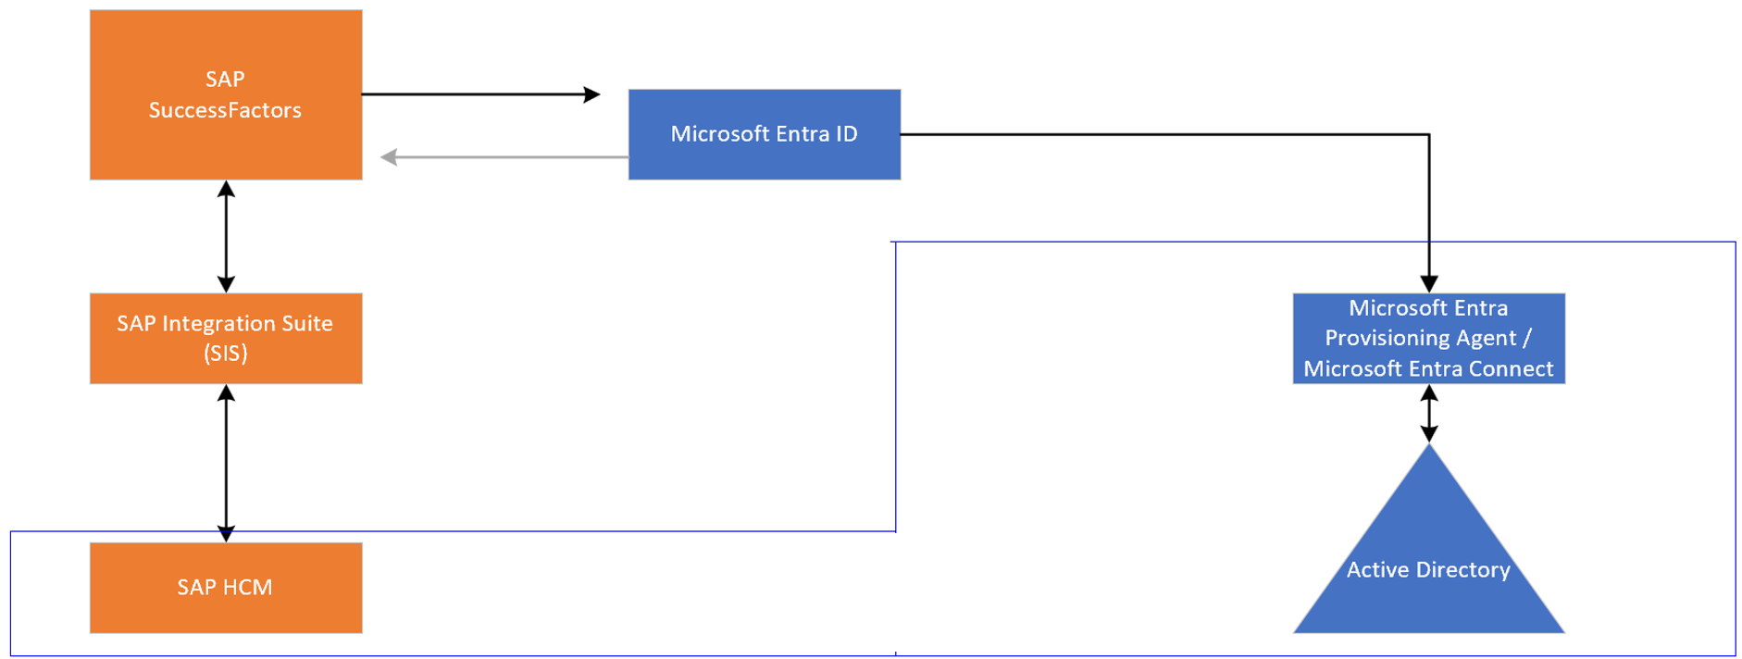
Integrate with SAP HCM + SF
Customers with HCM + SF can leverage this architecture
Notes:
What is HR-driven provisioning with Microsoft Entra ID? - Microsoft Entra ID | Microsoft Learn
Some organizations also used SAP IDM to read from SAP Human Capital Management (HCM). Organizations that use both SAP SuccessFactors and SAP Human Capital Management (HCM) can also bring identities into Microsoft Entra ID. By using SAP Integration Suite, you can synchronize lists of workers between SAP HCM and SAP SuccessFactors. From there, you can bring identities directly into Microsoft Entra ID or provision them into Active Directory Domain Services by using the native provisioning integrations mentioned earlier.

Slide 10
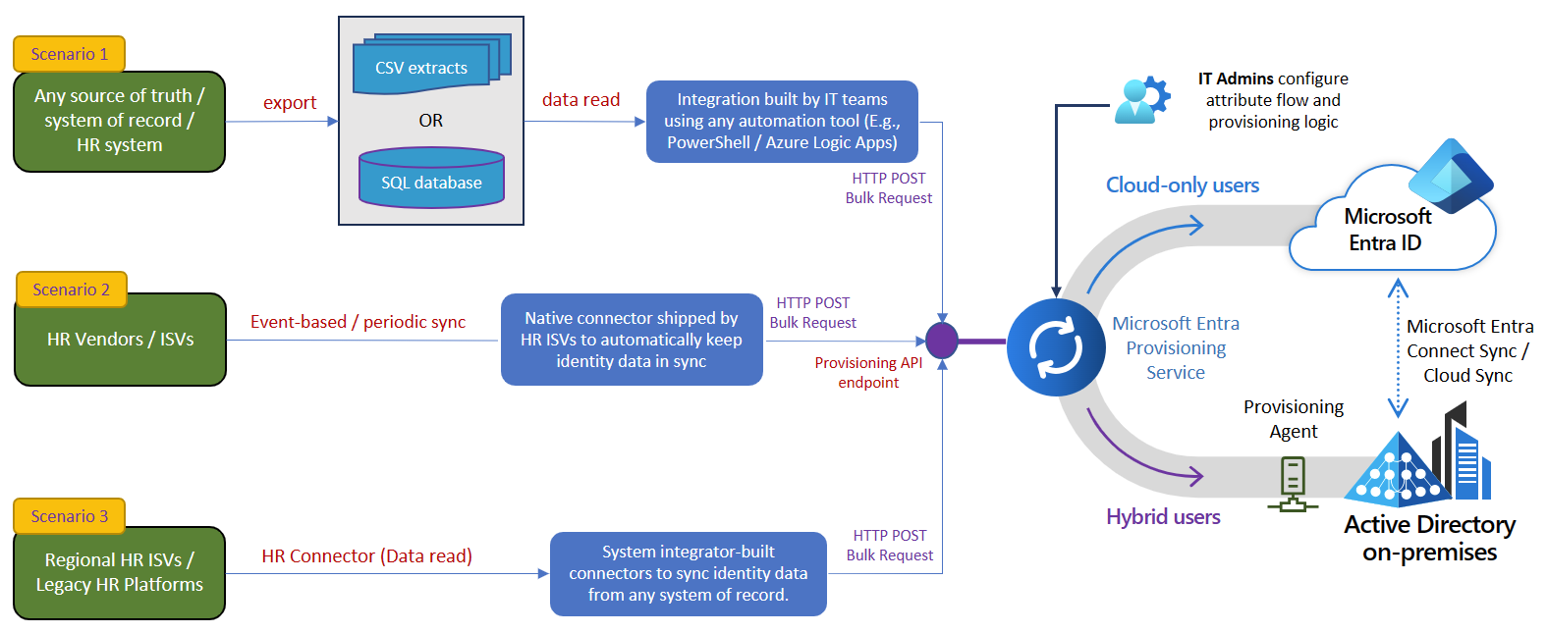
Use API-Driven Provisioning for Other HR Sources

Slide 11



Multiple HR Systems Scenario
As a system integrator, you may often come across this scenario, where…
Files generated by different HR sources
Customer needs to process multiple HR feeds. Multiple stakeholders:
HR team
Data Services team
IAM team
Direct connectivity to HR is not an option. Customer uses ETL to process HR feeds.
Front line workers and contractors are provisioned cloud-only accounts.
Corporate employees are provisioned first in on-premises AD and then synced to Entra ID.
Customer wants to govern access to AD-based applications using Entra ID.
Microsoft Entra ID
FLW-employee-feed.csv
Combine
Cloud Only Users
FLW-Badge-id.csv
Govern apps that use AD groups
Contractors.csv
Entra Connect /
Cloud Sync
Corp-employee-feed.csv
Hybrid User
Active Directory
on-premises
FLW = Frontline Workers
Corp = Corporate employees
ETL = Extract-Transform-Load
Notes:
In today's demo, we'll show you how to deal with a common situation that you might face as system integrators.
Let’s go over the core requirements in this case.
The customer has to handle data from different HR feeds. On the left, you can see the customer has different HR feeds for front-line workers, contractors and corporate employees. The customer can't connect directly to the HR sources, because their Data Service team handles all the data stuff and need ETL (Extract Transform Load) for HR data consumption. The customer wants to make cloud-only accounts for front-line workers and contractors. There's also another feed for Physical Access Badge that needs to be joined before syncing to Entra ID. Corporate employees get hybrid accounts that are made first on-premises AD and then synced to the cloud.
These customer requirements were not feasible a year ago. But now with features like API-driven provisioning and Group provisioning to AD, you can reliably sync data from various HR sources using the customer’s preferred middleware platform. We will demonstrate how to design and set up this solution in Microsoft Entra.

Slide 12




Multiple HR Systems Scenario – Integration Architecture
Owner: HR team
Owner: Data services team
Owner: IAM/IGA team
Files generated by different HR sources
Entra Provisioning Service
Microsoft Entra ID
FLW-employee-feed.csv
Process front-line-worker feed
FLW Employee Provisioning App
Cloud Only Users
FLW-Badge-id.csv
Guest accounts
Govern apps that use AD groups
Contractors.csv
Process contractor feed
Contractor Provisioning App
Entra Connect /
Cloud Sync
Provisioning
Agent
Corp-employee-feed.csv
Process Corp employee feed
Corp Employee Provisioning App
Hybrid User
Active Directory
on-premises
Notes:
Click one -> There are two important integration services that we’ll use to address the customer requirements – Azure Data Factory to preprocess the HR data and Entra Provisioning Service to perform the final account provisioning to Entra ID and on-premises AD. The good news is that most of our systems integrators and customers are familiar with both these services and when both are combined, you can accelerate the customer’s move to Cloud IAM.
Click two -> As you implement this integration, there may be different teams within the customer’s organization responsible for each service. Typically, Azure Data FActory is owned by the data services team and Entra is owned by the IAM/IGA team.
Click three -> The first data pipeline processes the Frontline worker feed. Here we use Azure Data Factory capabilities to merge two data feeds and convert them into a SCIM bulk request that you can upload to the API endpoint exposed by the “FLW Provisioning app“. This app provisions cloud-only accounts for front-line workers in Microsoft Entra ID.
Click 4 -> The second data pipeline processes the Contractor worker feed. This data flow uses different preprocessing logic, and the provisioning app creates “guest accounts” for these contractors.
Click 5 -> The third data pipeline processes corporate employee feed, creating/updating hybrid accounts for corporate users. These corporate users are synced to Entra ID. In the demo, we will see how the AD group access for these synced users can now be managed using Entra ID.
Click 6 -> This loosely coupled architecture provides several advantages to enterprise customers who have an established way of doing things using an ETL-based architecture. The HR data can be pre-processed, checked for accuracy and enriched even before it reaches the provisioning service. The distinct provisioning API endpoints and separate apps for each data flow provide IAM teams the much-needed flexibility around attribute flows and mapping. Let’s say the customer acquires a new company, they can just create a new pipeline to upload users belonging to that company. The provisioning service takes care of performing the right operation.
Let’s now go through the demo video to see this flow in action.

Slide 13







Lifecycle Workflows General Availability
Launch pre-hire workflow
Launch termination workflow
New worker joins
Worker separates from org
Automate join/move/leave employee lifecycle events
Organizations can schedule tasks to occur before, at or after a join or leave date; these can also be run on-demand.
Built-in tasks include generating temporary credentials, sending emails, updating user attributes, and memberships, and removing licenses.
Customers and partners can extend lifecycle workflows with additional tasks via Azure Logic Apps.
Other identity providers
Microsoft
Entra ID
Enterprise SaaS apps
HR Systems
On-premises apps
(AD-based)
Active Directory
on-premises
On-premises apps
(non-AD-based)
Notes:
Pre-defined workflow templates for most common user tasks.
Automatic trigger based on attribute state changes of user.
Custom policies for triggering workflows based on pre-defined or custom user states.
Extensibility and flexibility with Logic Apps
On-premises apps include SAML, OpenID Connect, Kerberos, Header-based authN,SCIM-based apps
Directories: AD LDS, 389, Apache, IBM Tivoli, Isode, NetIQ, Novell,
OpenDJ, OpenDS, Oracle, RadiantOne…
Databases: IBM DB2, Oracle, MySQL, SQL Server…

Slide 14
Single-Sign On (SSO)

Slide 15
SSO with SAP Cloud Identity Services
Use Federated Authentication in SAP Business Technology Platform and SAP SaaS applications through SAP Identity Authentication Service
Microsoft Entra Tenant
SAP IAS Tenant
SAP BTP Subaccount
Enterprise Application
Corporate Identity Provider
Trust
Application
Trust
Trust configuration
Scenario - Using Microsoft Entra ID to secure access to SAP platforms and applications
Tutorial: Microsoft Entra single sign-on (SSO) integration with SAP Cloud Identity Services

Slide 16






SSO with SAP Cloud Identity Services
SAP On-Premise
Solutions
SAP S/4HANA
Authenticate
Cloud Connector
Trust
SAP Cloud Identity
Microsoft Entra ID
SAP Cloud
Solutions
SAP S/4HANA Cloud
SAP Fieldglass
SAP SuccessFactors
SAP Ariba
SAP Concur
…
Scenario - Using Microsoft Entra ID to secure access to SAP platforms and applications
Tutorial: Microsoft Entra single sign-on (SSO) integration with SAP Cloud Identity Services

Slide 17
Demo – SSO Config

Slide 18
SSO with SAP ECC
Use Kerberos SSO if your users accounts are on On-Prem AD DS and SAP version doesn’t support SAML/OAuth
Use SAML or OAUTH SSO with Entra ID if you have:
SAP NetWeaver single sign-on (SSO) enabled subscription.
SAP NetWeaver V7.20 or later
SAP Single Sign-On: Authenticate with Kerberos/SPN... - SAP Community
Tutorial: Microsoft Entra single sign-on (SSO) integration with SAP NetWeaver

Slide 19
Migrate User Management Scenario
IT Administrators uses Microsoft Entra Admin Center, Microsoft Graph API or PowerShell to perform day-to-day identity management activities such as:
User management*
Group Management*
Provisioning (HR Inbound, Target App)
Access Policies and Entitlement Management
Audit, Monitoring and Reporting
* For Hybrid environments with On-Premises Active Directory, AD Admin Center, ADUC or PowerShell and are the main tools

Slide 20
Migrate User Management Scenario
If not already in use by IAM team, use Microsoft Entra Features to improve User Management and Identity Security:
Enable Microsoft Entra Password Protection
Enable Microsoft Entra self-service password reset for Users
Enable Microsoft Entra multifactor authentication methods
Enable Entra passwordless sign-in for Users
Use Microsoft Entra ID Protection risk-based access policies
Use Dynamic Groups to automate group management

Slide 21
App Provisioning

Slide 22
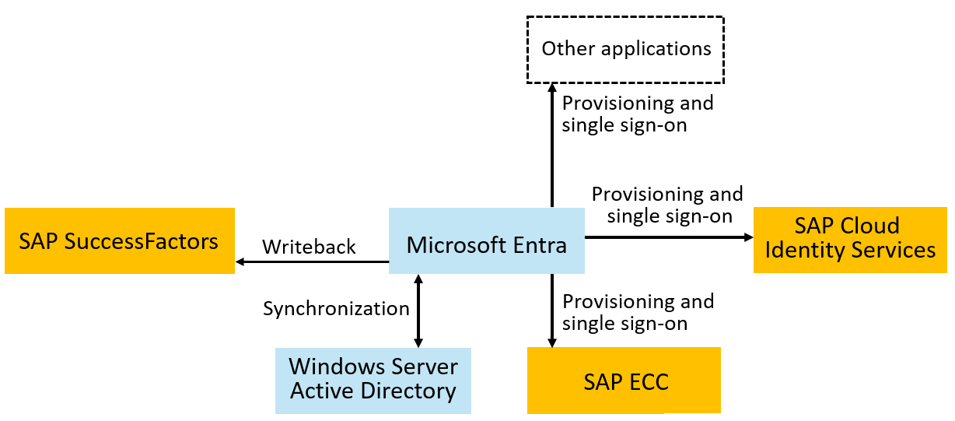
Provision to SAP systems
Microsoft Entra has connectors to SAP ECC, SAP Cloud Identity Servers and
Other SAP and non-SAP systems.
Notes:
organizations with SAP IDM will have used it to provision users into SAP ECC, SAP IAS, SAP S/4HANA, or other SAP applications. Microsoft Entra has connectors to SAP ECC, SAP Cloud Identity Services, and SAP SuccessFactors. Provisioning into SAP S/4HANA or other applications requires the users to first be present in Microsoft Entra ID. Once you have users in Microsoft Entra ID, you can provision those users from Microsoft Entra ID to SAP Cloud Identity Services or SAP ECC, to enable them to sign in to SAP applications. SAP Cloud Identity Services then provisions the users originating from Microsoft Entra ID that are in the SAP Cloud Identity Directory into the downstream SAP applications, including SAP S/4HANA Cloud, SAP S/4HANA On-premise through the SAP cloud connector, AS ABAP, and others.

Slide 23
Provision to SAP systems – SAP Cloud Identity Services
For SAP Cloud Identity Services, confirm the SAP Cloud Identity Services have the necessary schema mappings for those applications, and provision the users from Microsoft Entra ID to SAP Cloud Identity Services.
SAP Cloud Identity Services will subsequently provision users into the downstream SAP applications, as necessary.
You can also automate changes to the application role assignments in Microsoft Entra ID for SAP Cloud Identity Services.

Slide 24
Demo – App Provisioning

Slide 25
Provision to SAP systems – On-Premises SAP ECC
For SAP ECC, confirm that the necessary Business APIs (BAPIs) for SAP ECC are ready for Microsoft Entra to use for identity management, then provision the users from Microsoft Entra ID to SAP ECC.
If you are using SAP NetWeaver AS for Java with Windows Server Active Directory as its data source, then Microsoft Entra SuccessFactors inbound can be used to automatically create and update users in Windows Server AD.
If you are using SAP NetWeaver AS for Java with another LDAP directory as its data source, then you can configure Microsoft Entra ID to provision users into LDAP directories.

Slide 26
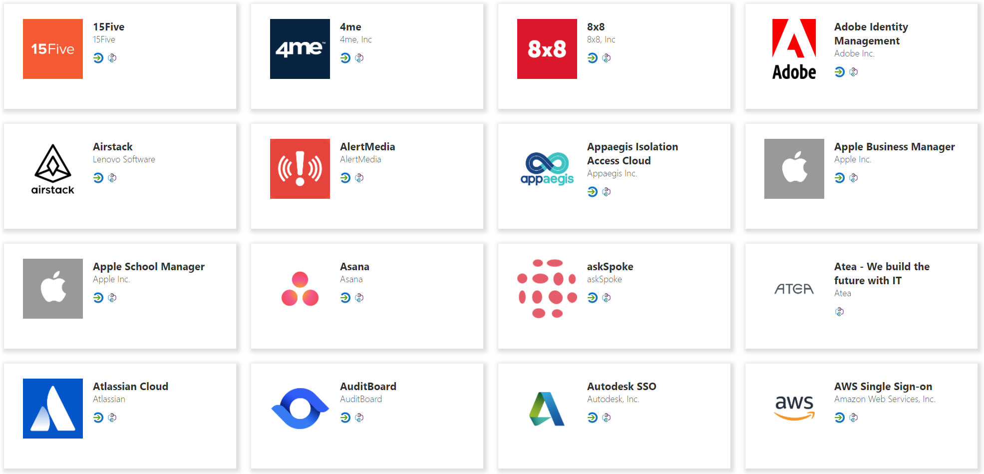


Provision to non-SAP Systems – SaaS
Entra Provisioning service connects to 3rd party apps via SCIM endpoints for user management
Automatically create, update or deactivate accounts in applications.
Ensure that the identities in your apps and systems are kept up to date based on changes in the directory or your human resources system.
Provision groups to applications that support them.
Take advantage of customizable attribute mappings that define what user data should flow from the source system to the target system.
Monitor and audit who has been provisioned into your applications.
The provisioning service provides alerts for critical events and allows for Log Analytics integration where you can define custom alerts to suit your business needs.
Microsoft
Entra ID
SaaS applications

Slide 27




Provision to non-SAP Systems – On-Premises
Users and schema defined in the cloud
Supports provisioning from custom schema extensions to app-specific properties.
Single sign-on and provisioning
SCIM
Translation to the provisioning protocols expected by apps
Microsoft-delivered connectors: LDAP, SQL, etc.
Ecosystem of third-party connectors for other apps requiring custom API integrations
Customers can re-use their existing MIM configuration
Microsoft Entra
provisioning agents
SOAP
LDAP
PS
SQL

Slide 28
Access Management

Slide 29
Access Management via Security Groups
Microsoft Entra makes group memberships available to applications via SAML claims, provisioning, or by provisioning security groups to WindowsServer AD. SAP Cloud Identity Services can read groups from Microsoft Entra ID via Graph, and provision those groups to other SAP applications.
Administrators can manage group membership, create access reviews of group memberships, and enable self-service group management.
Use Privileged Identity Management (PIM) for groups to manage just-in-time membership in the group or just-in-time ownership of the group.

Slide 30
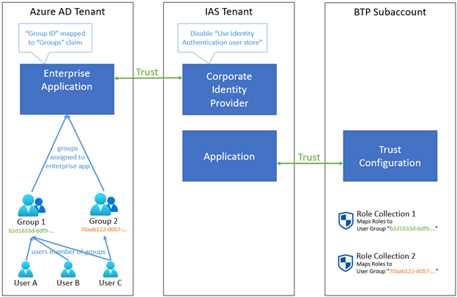
Access Management via Security Groups
Reuse existing groups or use Dynamic Groups to reduce group administration fatigue.
User PowerShell scripts to manage large set of Groups.
Using Microsoft Entra ID to secure access to SAP platforms and applications
Microsoft Entra Tenant
Notes:
Scenario - Using Microsoft Entra ID to secure access to SAP platforms and applications - Microsoft Entra | Microsoft Learn

Slide 31
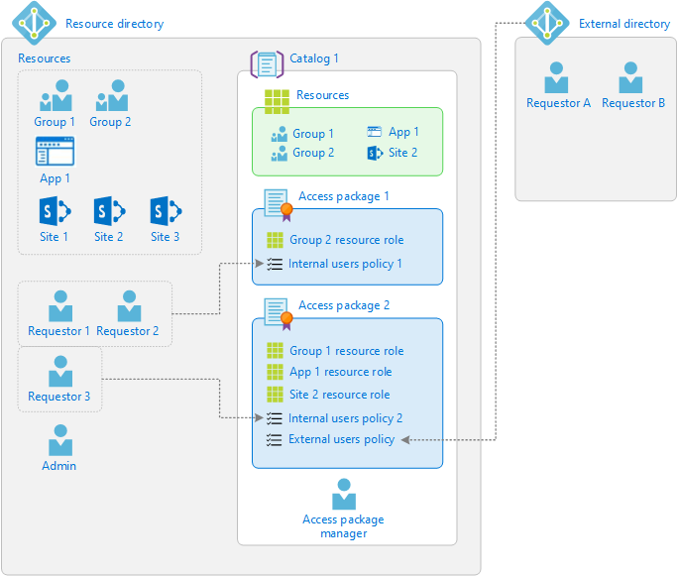
Access Management via Entitlement Management
Entitlement management is an identity governance feature that enables organizations to manage identity and access lifecycle at scale, by automating access request and approval workflows, access assignments, reviews, SoD, and expiration.

Slide 32
Demo – Group Mapping Configuration

Slide 33
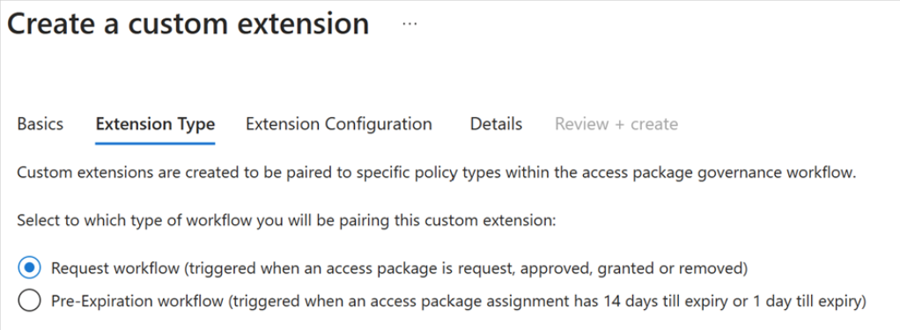
EM + Custom Extensions (Low-Code) General Availability
Use low-code solution, like Azure Logic Apps, to automate custom workflows and connect apps and services in one place.
Broaden your governance workflows beyond the core entitlement management use cases.
Example An admin could create and link a custom Logic App to entitlement management, so that when a user requests an access package, a Logic App is triggered that ensures the user is also assigned certain characteristics in a third-party App or perform GRC/SoD checks
Trigger Logic Apps with custom extensions in entitlement management
Notes:
Source: https://learn.microsoft.com/en-us/azure/active-directory/governance/entitlement-management-logic-apps-integration

Slide 34
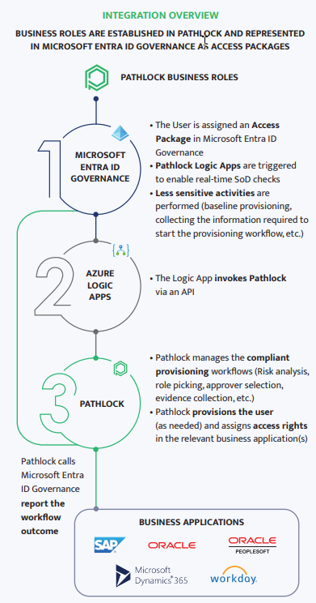
Access Management via Entitlement Management + external GRC product
With the integration from Microsoft Entra ID Governance to Pathlock and other partner products, customers can take advantage of fine-grained separation-of-duties checks enforced in those products, with access packages in Microsoft Entra ID Governance.
Notes:
Pathlock and Microsoft Entra ID Governance | Pathlock

Slide 35
Use Microsoft Entra for reporting
Microsoft Entra includes built-in reports, as well as workbooks that surface in Azure Monitor based on audit, sign-in, and provisioning log data.
Usage and insights reports for an application-centric view on sign-in data.
Monitor for unusual account creation and deletion, and unusual account usage.
Query Microsoft Graph to obtain data for use in a report. For example, you can retrieve a list of inactive user accounts in Microsoft Entra ID.
Notes:
Migrate identity management scenarios from SAP IDM to Microsoft Entra | Microsoft Learn

Slide 36
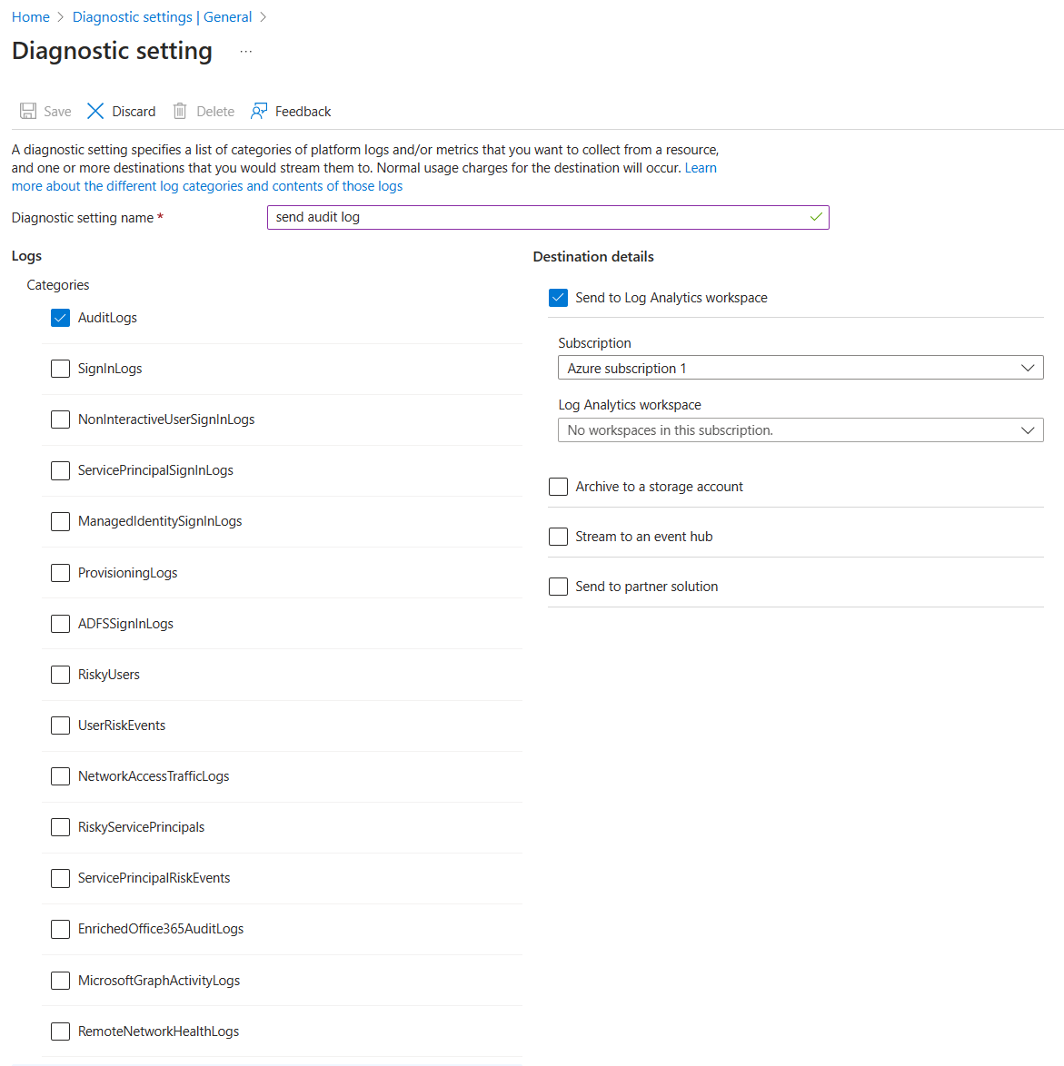
Use Microsoft Entra for reporting
Export data for SIEM, Azure Monitor or other storage solutions
Archive & report with Azure Monitor - Entitlement Management Reporting
Notes:
Migrate identity management scenarios from SAP IDM to Microsoft Entra | Microsoft Learn

Slide 37
Use Microsoft Entra for reporting
You can export data from Microsoft Entra admin center for use in generating your own reports. For example, you can download a list of users and their attributes or download logs, including the provisioning logs, from the Microsoft Entra Admin Center.
You can create custom reports with Azure Data Explorer, PowerBI or other tools you are familiar with.
You can use the PowerShell cmdlets atop Microsoft Graph APIs to export and restructure content suitable for reporting.
Notes:
Migrate identity management scenarios from SAP IDM to Microsoft Entra | Microsoft Learn

Slide 38
Extend Microsoft Entra through integration interfaces
Applications can call Microsoft Entra via the Microsoft Graph API to query and update identity information, configuration and policies, and retrieve logs, status, and reports.
Administrators in a tenant with Microsoft Entra ID Governance can also configure calls to custom Azure Logic Apps from entitlement management and lifecycle workflows. These allow customization of the user onboarding, offboarding, and access request and assignment processes.
Custom connectors are available via Services and integration partners
Notes:
Microsoft Entra includes multiple interfaces for integration and extension across its services, including:
Applications can call Microsoft Entra via the Microsoft Graph API to query and update identity information, configuration and policies, and retrieve logs, status, and reports.
Administrators can configure provision to applications via SCIM, SOAP or REST, and the ECMA API.
Administrators can use the inbound provisioning API to bring in worker records from other system of record sources to supply user updates to Windows Server AD and Microsoft Entra ID.
Administrators in a tenant with Microsoft Entra ID Governance can also configure calls to custom Azure Logic Apps from entitlement management and lifecycle workflows. These allow customization of the user onboarding, offboarding, and access request and assignment processes.

Slide 39
Recommended SAP IDM Migration Roadmap
Connect your HR Sources to Microsoft Entra
Connect your Apps for Provisioning and SSO
Map how each app integrate with Microsoft Entra
Establish order for Apps Integration
Set up Access Management for Apps using Entra ID
Enable Self-Service User Management capabilities
Create your reports and workbooks
Deploy any customization or low-code extension
Enable Lifecycle Workflows for J/M/L

Slide 40
Reference Architecture

Slide 41
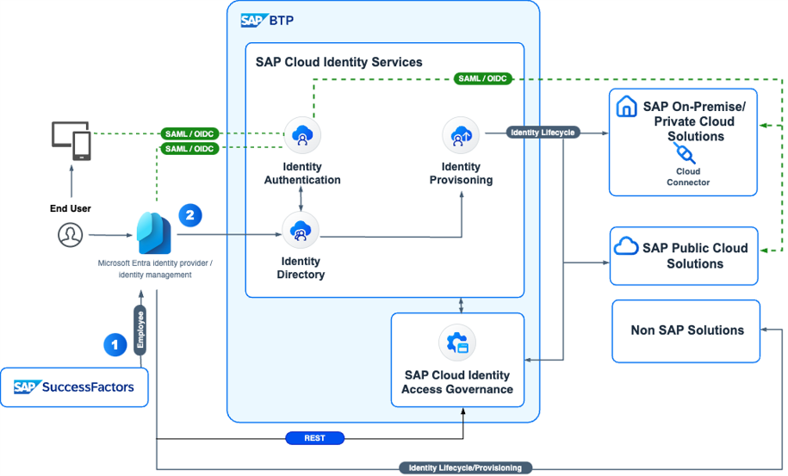
Microsoft Entra + SAP IAG Reference Architecture
Notes:
Cross-enterprise identity management and access governance integration based on
Microsoft Entra ID and Microsoft Entra ID Governance
SAP Cloud Identity services
SAP Cloud Identity Access Governance
Organizations will be able to integrate Microsoft Entra for single sign-on and provisioning with SAP business applications including SAP S/4HANA Public Cloud, SAP Ariba, SAP Concur, and SAP SuccessFactors.
Additionally, organizations will be able to link Microsoft Entra ID and Microsoft Entra ID Governance with SAP Cloud Identity Access Governance to enable integrated identity and access risk checks along with compliance controls monitoring and management.

Slide 42
Go Do’s
Review our Microsoft Entra ID Governance Training Content
Review our SAP IDM Migration guide
Review our videos tutorials for SSO, Provisioning, and Access Management with SAP Cloud Identity Services
Save our SAP repository and stay tunned for future updates: https://aka.ms/EntraSAPScenarios
For automation, refer to our Microsoft Graph PowerShell, Microsoft Entra PowerShell or Microsoft Graph API documentation.

Slide 43
Q&A

Slide 44
Thank You

